Slide 1
COMP 310
Simple File System (SFS)
Maruthi
11/14/2019
Unrestricted

Slide 2
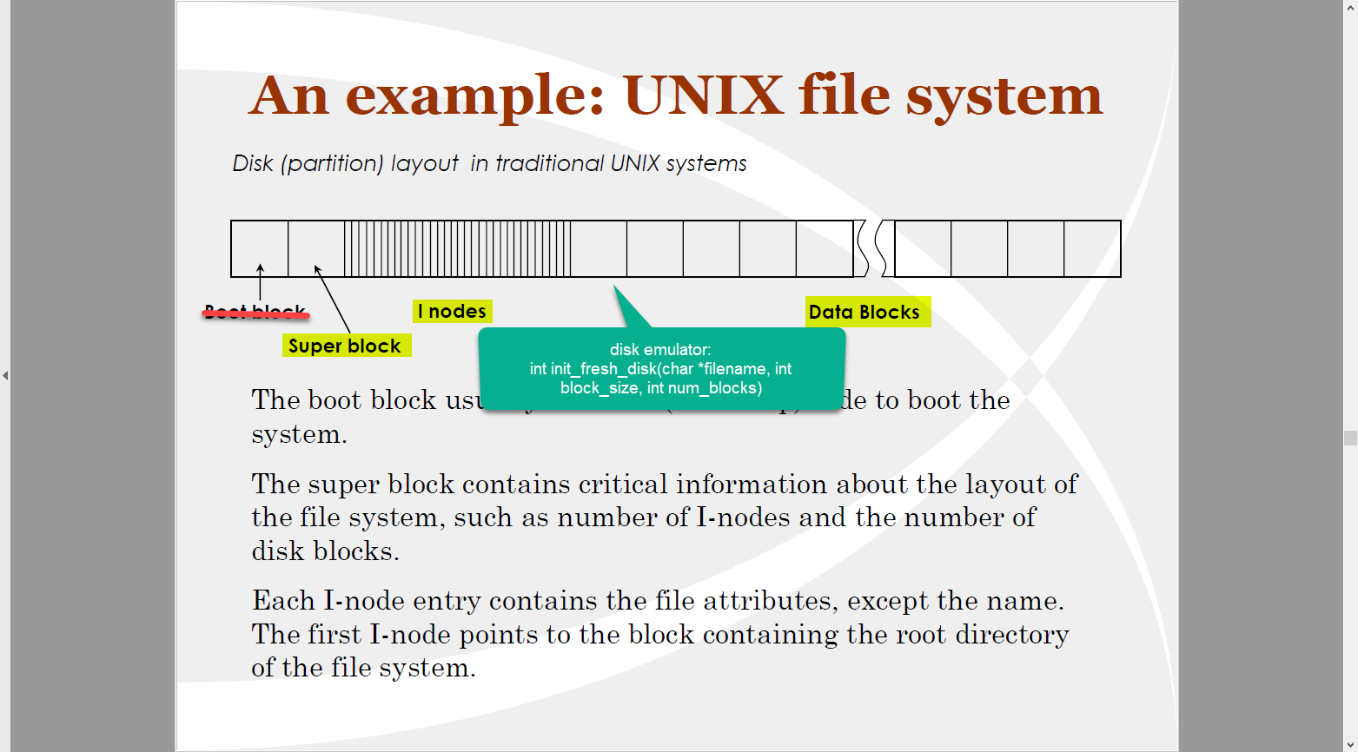

Slide 3
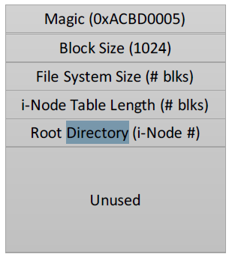
Data structures : Super block
Describes file system layout
On disk? Or in memory?

Slide 4
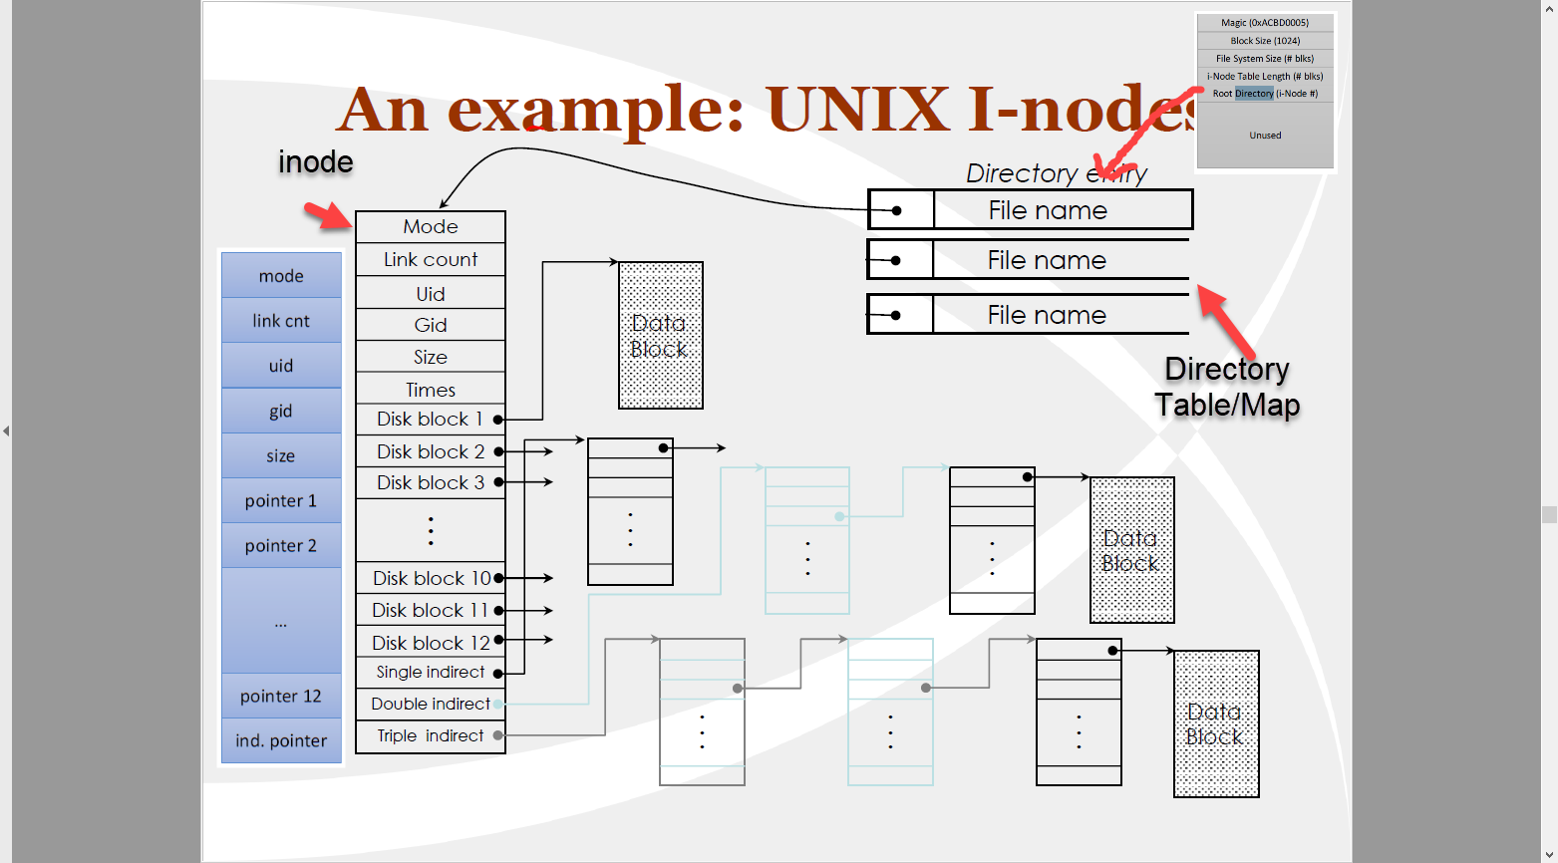
On disk? Or In memory?

Slide 5
SFS initialization
Create disk using disk emulator
Initialize super block
Initialize Inode
Initializations for directory
….. Some other initialization…
Questions to ask?
How many blocks on disk?
What is the block size? - 1024
How many inodes per block? – Depending on inode size

Slide 6
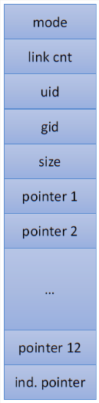
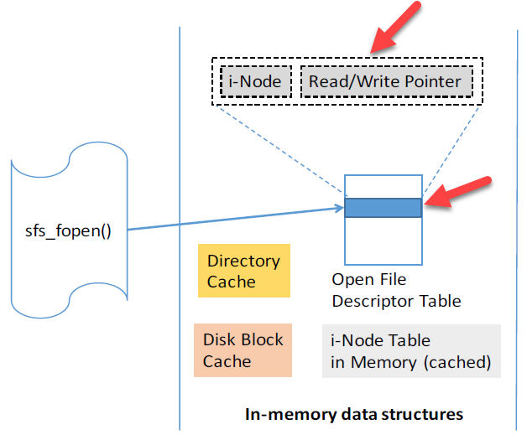
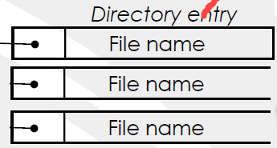
Creating file
1
Create and initialize inode
3
Update file descriptor table
2
Update directory entry

Slide 7
Creating file
Questions to ask
What if there is already a file by this name?
What if the file is already open?
Is an inode available to create a new file?
Does any parameter need to be updated in the super block?

Slide 8

Reading and Writing files
If you understood creating file, you know how to read and write.

Slide 9
Questions + Networking
Discussion is encouraged. Absolutely no plagiarism, however.

